Slide 1

ỦY BAN NHÂN DÂN THÀNH PHỐ HỒ CHÍ MINH
TRƯỜNG CAO ĐẲNG LÝ TỰ TRỌNG TP. HỒ CHÍ MINH
Bậc đào tạo: TRUNG CẤP (9+4)
Tên giảng viên: ĐINH TRẦN PHƯƠNG THẢO

Slide 2
ENGLISH FOR THE AUTOMOBILE INDUSTRY
UNIT 1: INTRODUCTION TO THE CAR

Slide 3
INTRODUCTION TO AUTOMOBILE ENGINEERING
The automobile is a self propelled vehicle that travels on land – William H Crouse
An automobile is a wheeled vehicle carrying its motive power unit – Kirpal Sing.
Automobile is a vehicle driven by an internal combustion engine and it is used for transportation of passengers and goods on the ground. Automobile can also be defined as a vehicle which can move by itself.
Examples : Car, jeep, bus, truck, scooter, etc

Slide 4
HISTORY
The automobile has been around for more than 100 years
The first car was built by Joseph Cugnot in 1769. It was powered by a steam engine and was very slow.
Richard Trevithick improved the steam engine’s design by making them smaller and lighter.
In 1801 he put one on wheels. It was the 1st horseless carriage that could transport passengers.
Jean Joseph Lenoir was the first to build the one cylinder engine, internal combustion engine.
Nikolaus August Otto built the first four cylinder engine.

Slide 5
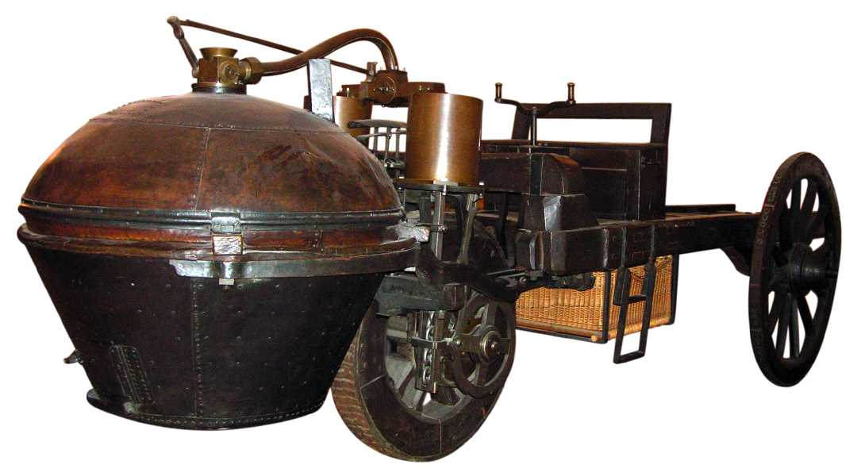
Joseph Cugnot Steam Car

Slide 6
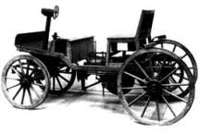
Richard Trevithick Horseless Carriage

Slide 7
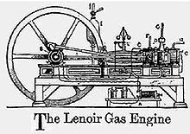
Jean Joseph Lenoir Engine

Slide 8
History
Karl Benz, known as one of the founders of Mercedes-Benz, is the first to build an automobile powered by an internal combustion engine in 1885.
In 1886 Gottlieb Daimler designed the first four wheeled automobile. They also created the first v-slanted engine.
After 1886, Benz also inveted accelerator for speed regulation, battery ignition system, spark plug, clutch, gear shift, and the radiator for cooling the engine.
With these improvements, he started with production of the automobile, the first in the world, in the year 1888.
However in the year 1893 that the first for wheeled automobile was introduced by him.

Slide 9
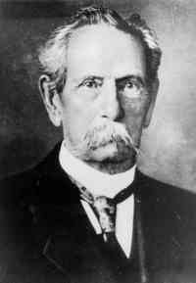
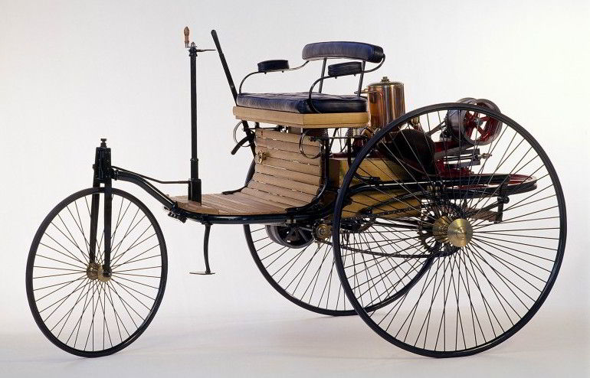
Karl Benz Invention

Slide 10
Present
Today, the automobile industry is one of the biggest in the world.
In recent years tremendous changes have taken place in the automobile industry.
Two powerful forces have been at work
  The challenges of foreign automotive manufacturers
  Federal laws made by the Government covering,
    Automotive air pollution.
    Automotive Safety.
    Automotive fuel economy.

Slide 11
Present
These two forces have caused the manufacturers to develop new generations of
    Light weight vehicles
    Fuel efficient vehicles.
This is an ongoing revolutionary process.
Each year, automotive manufacturers bring out new models that improve on fuel efficiency and performance with less air pollution.
The competition among manufacturers has resulted in many innovations that are being widely adopted.

Slide 12
New Innovations
A few of these innovations include
  Antilock braking system (ABS)
  Traction- Control System (TCS)
  Four- wheel steering
  Four-wheel drive (4WD)
  All- wheel drive (AWD)
  Electronically- controlled and active suspension system
  Supplemental restraint system ( air bags)
  Sequential port fuel injection
  And a host of other innovations

Slide 13
Design-Manufacturing-Automobile
Engineering design and manufacturing skill have made the modern motor car simple to operate and economical to maintain
To achieve utmost simplicity of operation, and thus ensure greatest utility, engineers have made many design improvements and have added devices from time to time. E.g.
  Electric self starter
  Automotive oil pressure and engine temperature gauges
  Synchromesh transmission
  Automatic gear shifting mechanism

Slide 14
Design-Manufacturing-Automobile
Manufacturing skill, combined with improved designs, has affected great savings so that economical transportation has been become available to many millions.
At the same time improvements in manufacturing method have made it possible to use better material and closer tolerances so that car life has been tremendously increased.

Slide 15
Components of a four wheeler Automobile
About 1500 separate parts are put together to make an automobile.
These parts are grouped into several systems.
Each system is made up of two or more parts that work together to perform a specific job.
The automotive vehicles are produced in large variety of sizes and shapes.
All have the same basic parts and systems.

Slide 16
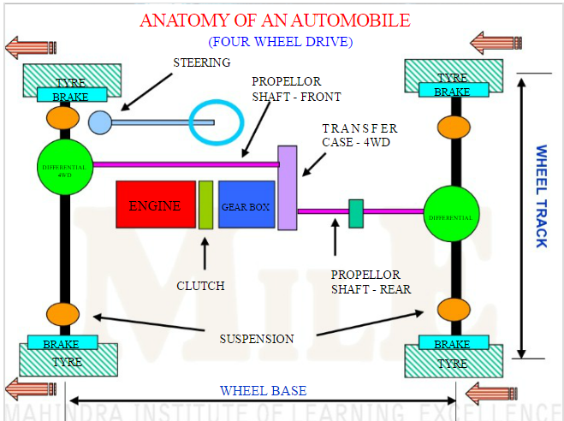

Slide 17
It is the most common question that arises when you are in the market looking for a new car but not sure what kind of car suits your personality, budget and practicality wise.
To help you through this confusion and aid you in making a choice we've compiled a brief description of the most popular vehicle types.
Different Types of Car Body Styles
Small City Car | Hatchback | Coupe
Convertible/Cabriolet | Sedan/Saloon | SUV
MPV | Estate | Crossovers

Slide 18
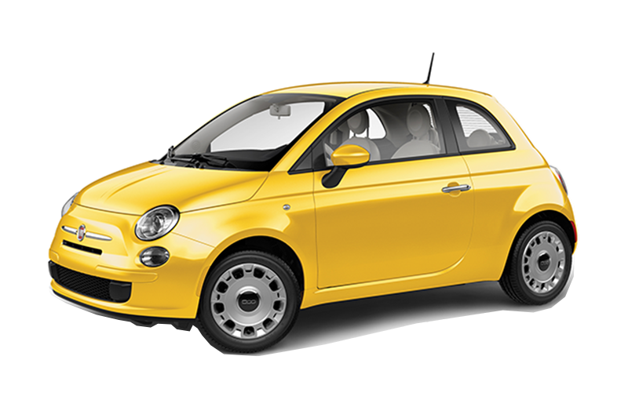
Small City Car
Small city cars are best known and most suitable for city drivers. Designed with narrow streets, small parking spaces and heavy traffic in mind, they are the smallest type of car you can realistically own. While driving on motorways its limited to certain top speeds and feels very comfortable.
Highlights:
Low running costs
Higher fuel efficiency
Comfortable ride
Practical Interior
Best for:
New Drivers : Small city cars has lower insurance group
Single or Couple
Against:
If you are a family person, then hatchbacks would be more practical than small city cars due lack of legroom, headroom and passenger space.
https://www.selectcontracts.co.uk/

Slide 19
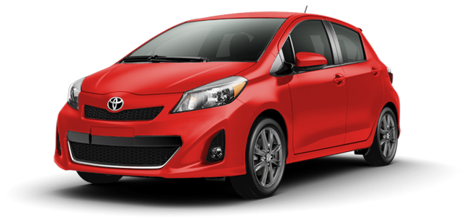
Hatchback
Hatchbacks are more practical than small city cars. Best known for fun driving and suitable for small families.
For everyday driving, hatchbacks can be a better option, thanks to its small size having less engine capacity, consume lesser fuel and provide better mileage.
Highlights:
Value for money
Better equipped
Comfortable & more practical
Best for:
Everyday use
Small families
https://www.selectcontracts.co.uk/

Slide 20
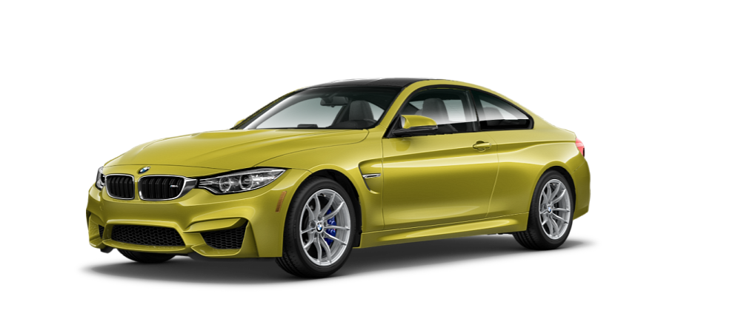
Coupe
A coupe is generally a two-door car that generally has either 2 seats or 4 seats placed in a 2+2 configuration.
You don’t have to sacrifice practicality to enjoy a healthy dose of style. It’s normally called the sporty variants of sedan (saloon) body style. Some of the car manufacturers provide four-door coupes
Highlights:
Beautiful design and unmatched style
Majority of coupes are two-doors.
Comfortable & gives you sporty feeling
Best for:
Sports lovers
https://www.selectcontracts.co.uk/

Slide 21
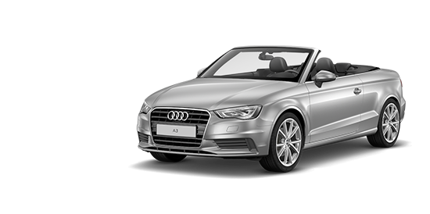
Convertible/Cabriolet
A convertible or cabriolet is a body style with a foldable or retractable roof.
Such cars often have canvas or vinyl roofs, though nowadays these are also made of plastic, aluminium or steel.
Convertibles are usually two-door cars.
Highlights:
Open-roof driving
All-round visibility
Enhanced driving pleasure
Maximised ventilation
Best for:
Great enjoyment in a sunny day
https://www.selectcontracts.co.uk/

Slide 22
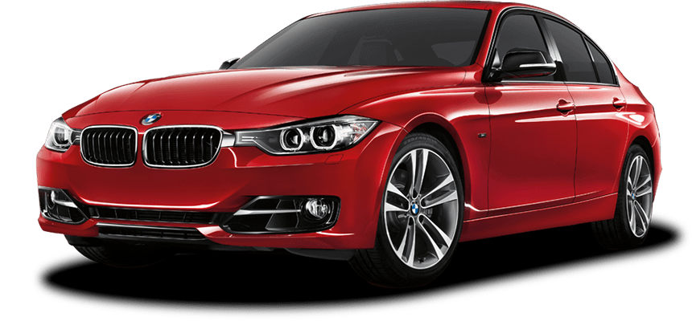
Sedan/Saloon
Sedan also known as Saloon, determining the best executive cars on the UK market. They’re also called all-rounders that deliver both performance, space and business-friendly running costs.
Highlights:
Space, style and better mileage
Makes longer journeys comfortable
Decent passenger and cabin space
Best for:
Executive drivers and family people
https://www.selectcontracts.co.uk/

Slide 23
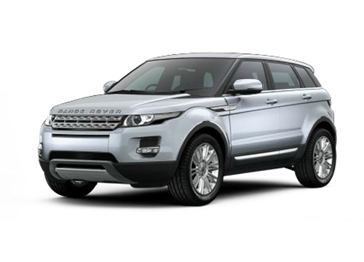
SUV
A SUV refers to a Sport Utility Vehicle, which is similar to an estate, but usually have higher and bigger off the ground.
It offers the passenger carrying capacity of a minivan or large sedan.
Highlights:
Extra seating capacity
Towing capacity
Vehicle handling & safety
More horse power
Seating and hauling versatility
Best for:
Off-road and on-road driving
Better for bigger families
https://www.selectcontracts.co.uk/

Slide 24
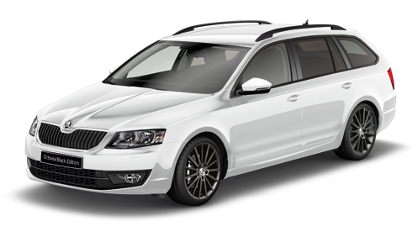
Estate
Estates have a similar body style to a sedan, but with an extended rear luggage or cargo area and often share the same frontal design to sedan.
Highlights:
Best for boot space
Better load space
Comfortable ride
Better handling & same fuel consumption
Best for:
Choice for families and anyone needing to carry a lot of luggage.
https://www.selectcontracts.co.uk/

Slide 25
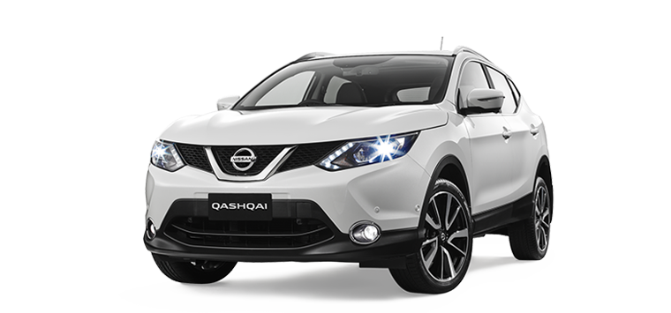
Crossovers
A crossover is a vehicle built on a car platform but often with features of an SUV like increased ground clearance and a higher seating position. Crossovers are typically designed only for light off-roading.
Highlights:
Great road manners
Higher ground clearance & interior
space of an SUV
Comfortable ride and good handling
Best for:
Choice for families and anyone needing to carry a lot of luggage.
Best for light off-roading
https://www.selectcontracts.co.uk/

Slide 26




THANK YOU VERY MUCH

